Slide 1

Coding in Javascript
Apr 2018
Instructors:
Jeremy

Slide 2
Introductions.
What is your name?
What would you like to learn?

Slide 3
Breaks.
~10:30am
~12:30pm

Slide 4
What we will be doing
Learning Javascript
Basic coding concepts
Building an endless shooter
Using our own web servers

Slide 5
Lesson 1 - Concepts & Game Intro

Slide 6
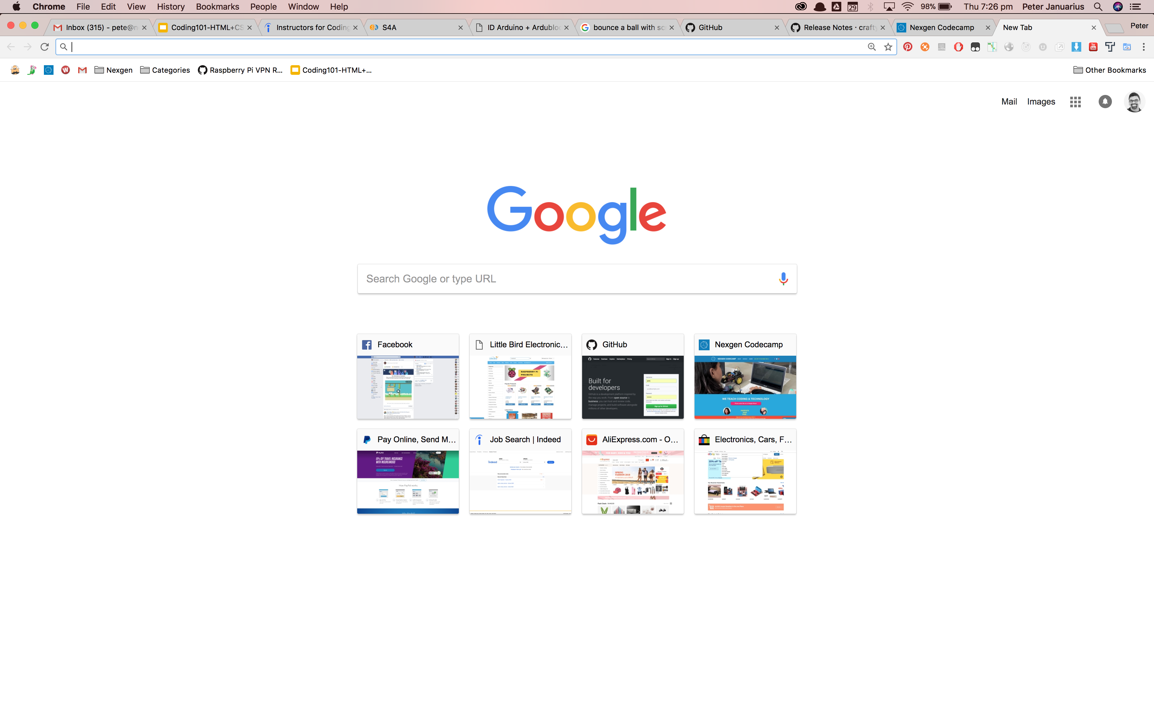
Every webpage is rendered (displayed) by your browser in HTML

Slide 7
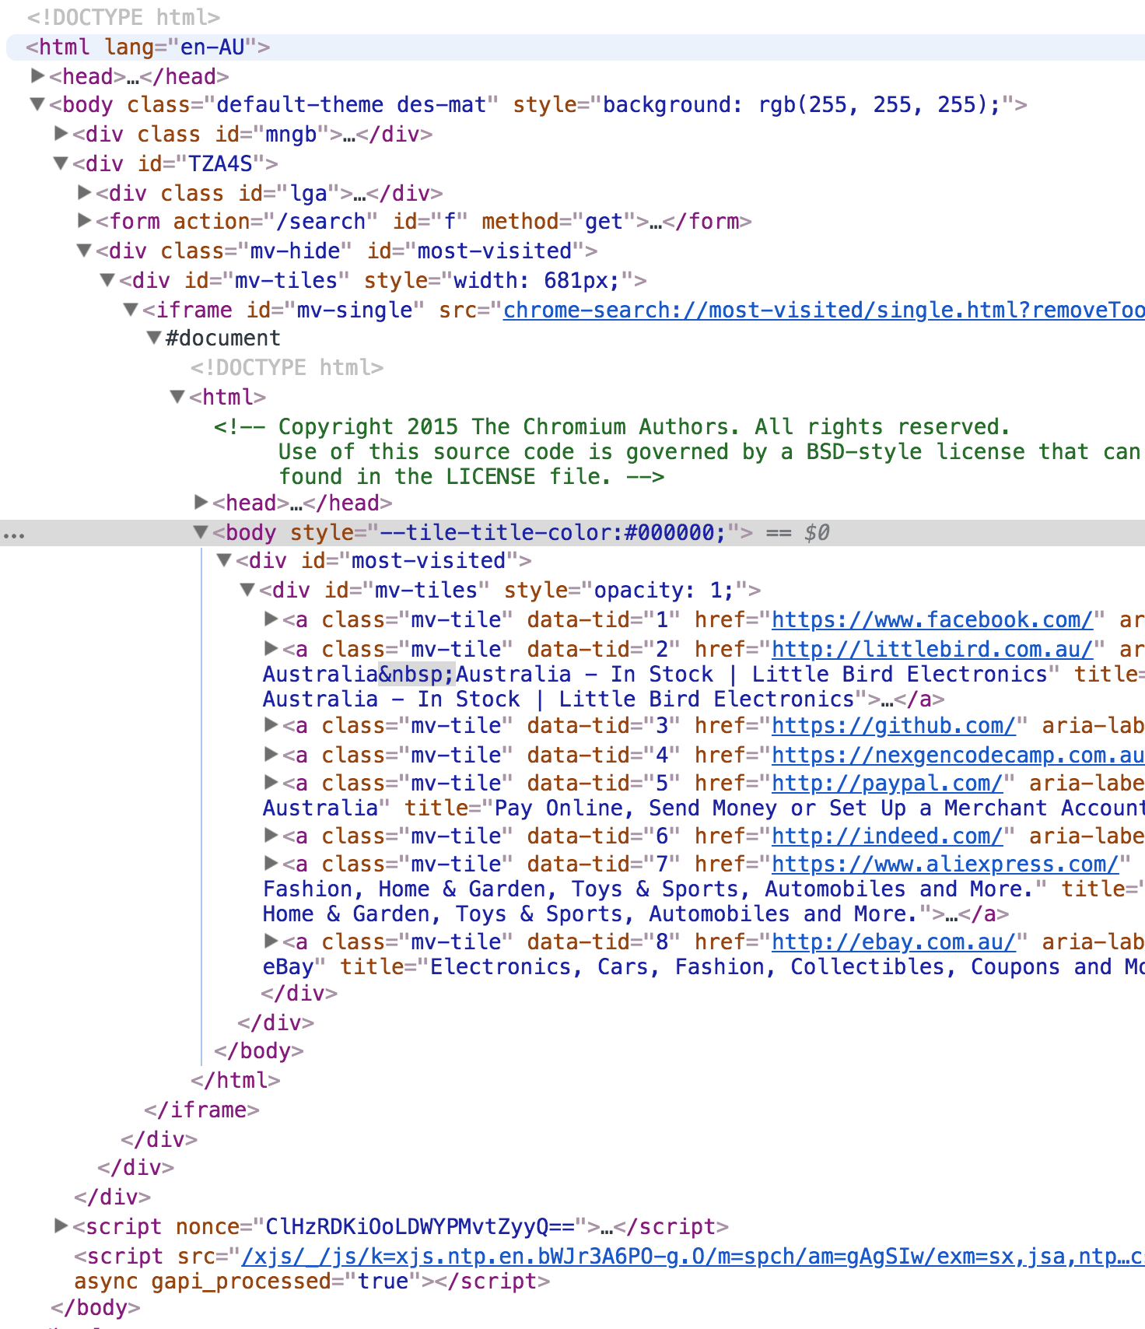

Slide 8
An HTML page is essentially the structure or the look of the page:

Slide 9
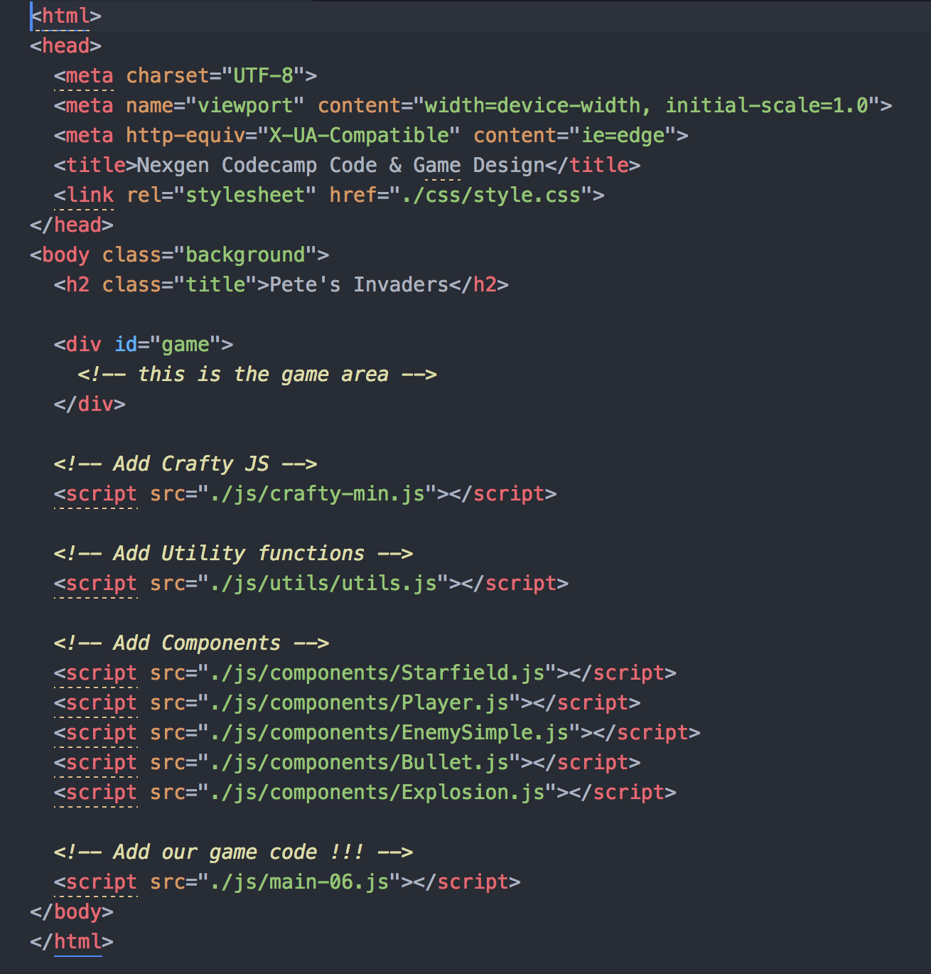
An HTML page also contains links to stylesheets (css) and code (javascript):

Slide 10
JavaScript is a cross-platform, object-oriented scripting language used to make webpages interactive
Mac/Windows/Linux
System built with Objects
Mouse over, Click, Keypress

Slide 11

Variables (containers)
Variables are used to store data/information such as numbers or characters
Variables have names and values
var score = 1000
var game = “Pacman”
score
game

Slide 12
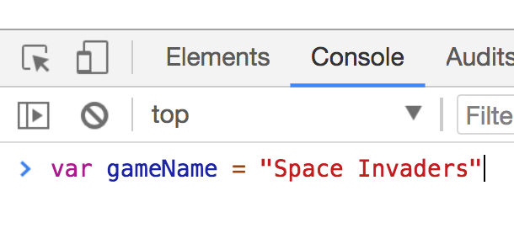
Open Google Chrome
Use Ctrl+Shift+I (or Cmd+Opt+I on Mac) to open the DevTools.
Click on the ‘Console’ tab
Create a variable of your choice and hit enter to add it to Chrome

Slide 13
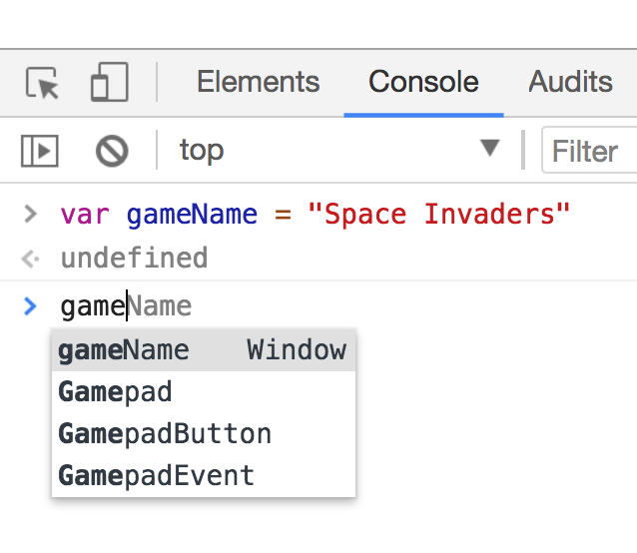
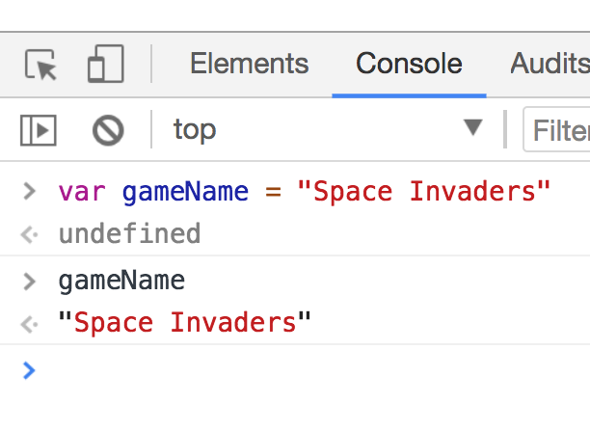
Type in the variable name. You will see that Chrome has it stored
Hit the Enter key. Chrome will display the variable value

Slide 14
Function (actions)
Function name
Function parameter
Function keyword
function add ( n1, n2 ) {
return n1 + n2;
}
Function code/body

Slide 15
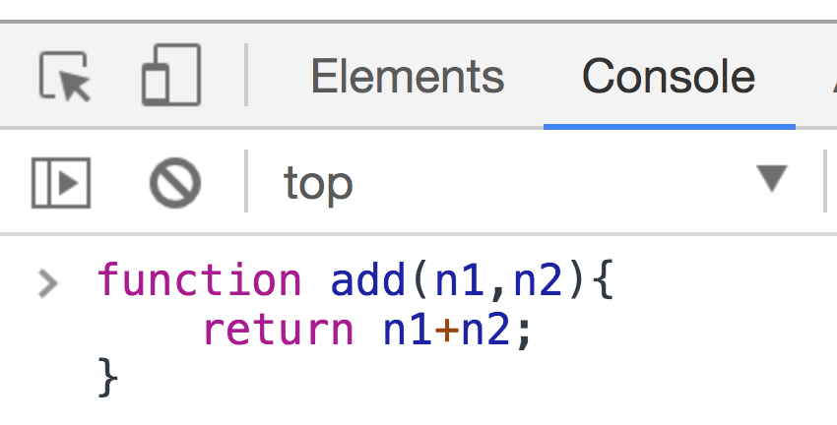
Create the ‘add’ function in Chrome
Once created, call the function, passing two numbers to add:
add(2, 3)

Slide 16
HEX Colors
#BE0712
#1E9C5A
#FFFD38
#6F359E

Slide 17
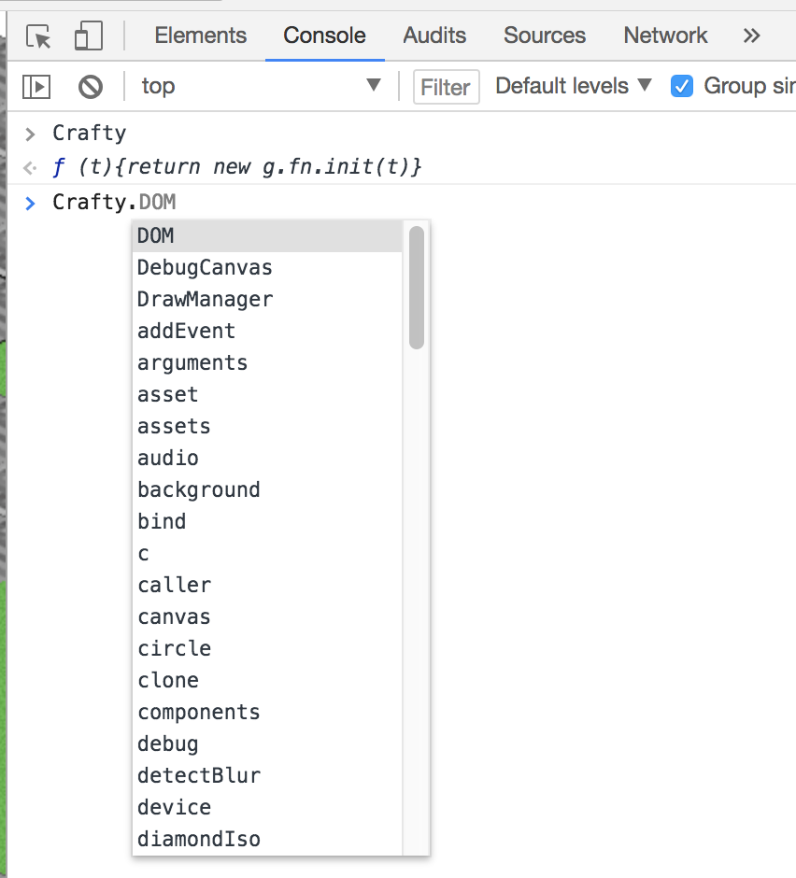
Introducing the ‘Crafty’ Object
Crafty JS is a Javascript game library (engine) that helps us to build games in Javascript
To use it we my add the crafty.min.js file to our HTML page with a <script> tag
Type ‘Crafty’ in Chrome Dev Tools, console tab and then . (dot)

Slide 18
Lesson 2 – Creating a Starfield

Slide 19
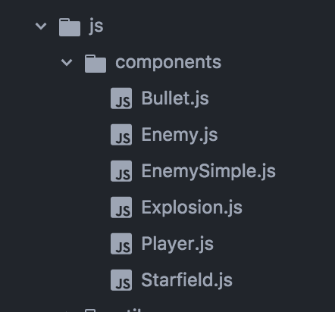
Creating a Starfield Object
The Starfield code is found in js/components/Starfield.js

Slide 20
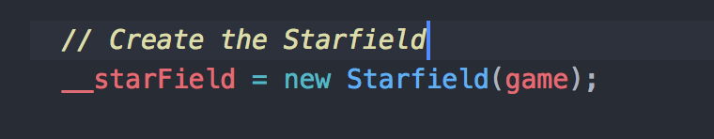
We use the ‘new’ keyword to create new Javascript Objects:
Once, created, __starField can now be used to create a moving star Field in the game. You can have
Different numbers of stars running at different speeds
The Starfield function takes 1 parameter (game)

Slide 21
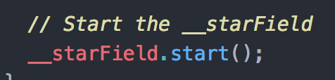
To call a method on an object, we use the dot notation

Slide 22
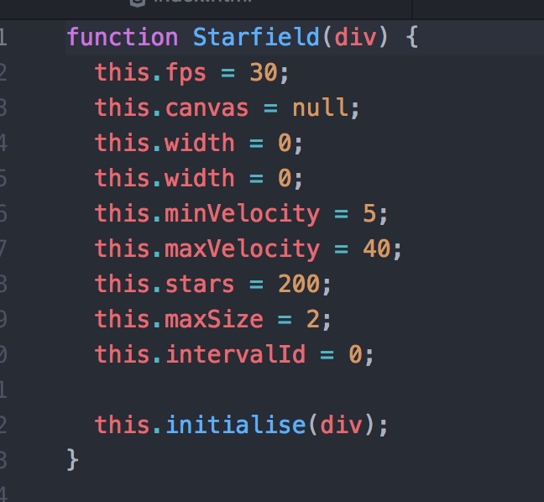
Looking at the code for the Starfield in Starfield.js, we can see that we could alter the velocity, size and number of stars quite easily.

Slide 23
Lesson 3 – Adding a Player

Slide 24
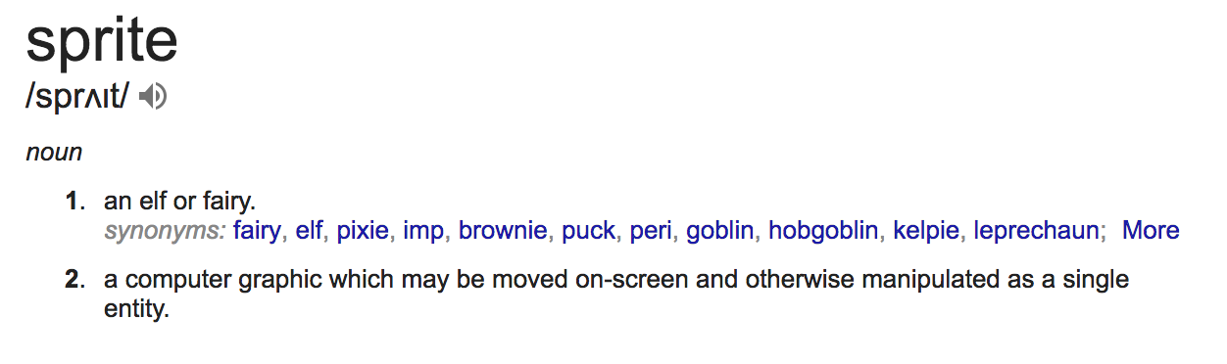
What is a Sprite ?

Slide 26
Sprites on a Grid
(0,0)
(1,0)
(2,0)
(0,1)
(0,2)
(1,3)
(?,?)

Slide 27
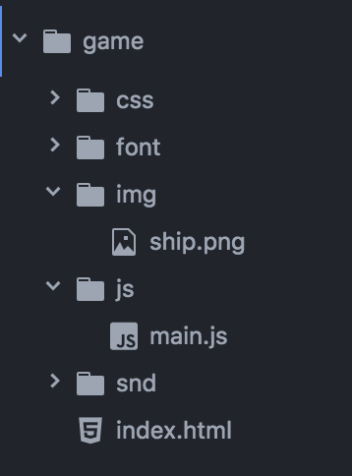
Relative Directories
Move back one directory with ‘..’
../img/ship.png
Current working directory
./main.js
../index.html

Slide 28
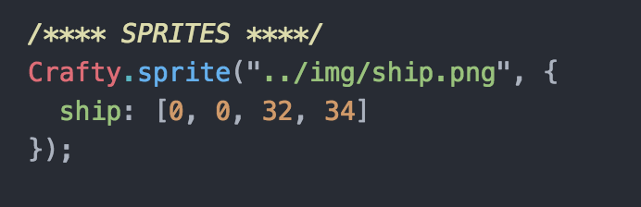
Create a Sprite with Crafty
Call sprite() method
path to ship image, ship.png
Crafty Object
name of sprite
width, height
col/row of sprite map

Slide 29
Entities in Crafty
An entity is some thing in your game. If that sounds vague, it's because practically anything can be an entity -- the player, the enemies, a projectile, a high score counter, or a menu item.
Entities are made up of components, which you can think of as bundles of functionality. Crafty provides several built-in components, and you can also define your own with Crafty.c().
Creating an Entity:
You create an entity with Crafty.e(). In most cases you'll pass in a list of the components you want to start with:
var square = Crafty.e("2D, Canvas, Color");

Slide 30
Components in Crafty
var __player = Crafty.e("2D, Canvas, Color, Player");
Position/2D component
Player component
Canvas component
The entity that you have created in a variable called ‘square’
Color component
Crafty has a lot of built-in components, but creating your own is a good way to organize your game.

Slide 31
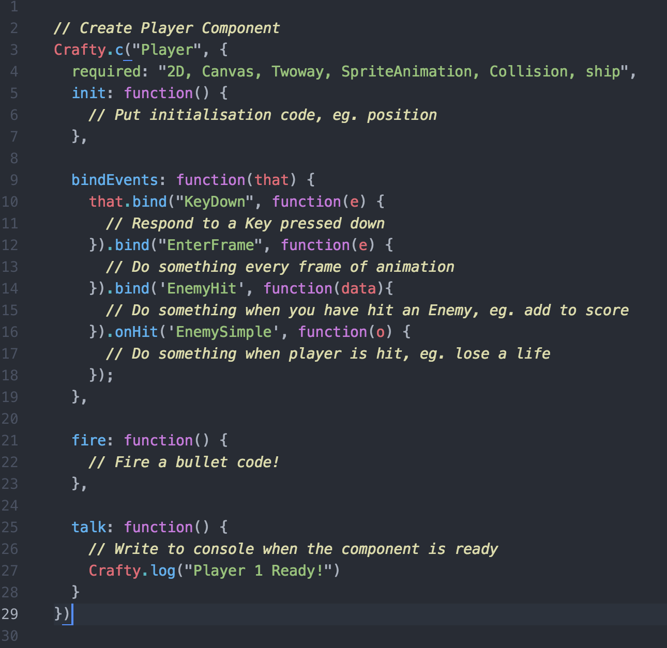
Player.js file

Slide 32
Lesson 4 – Variables & an Enemy

Slide 33
Variable Scope
Recap: What is a variable ?
value
code
container
name

Slide 34
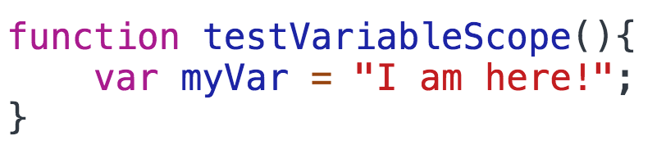
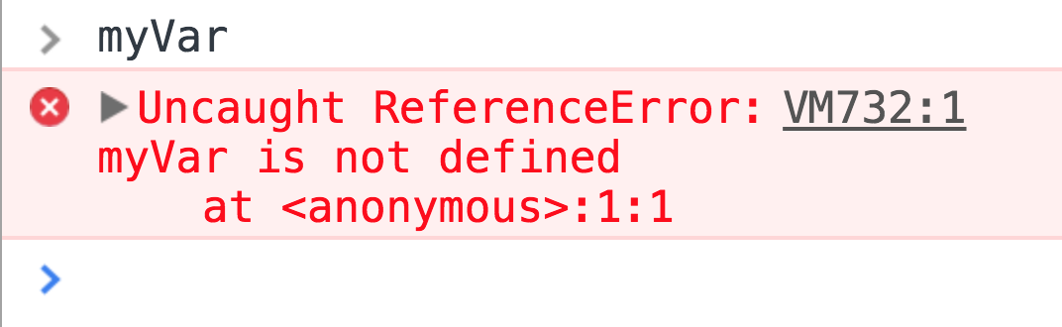
Variable Scope
Create a variable inside a function in
Chrome Dev tools.
Type the variable name and then ENTER
What just happened and Why?

Slide 35
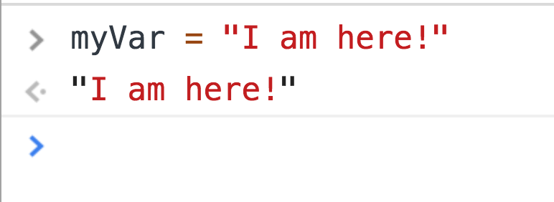
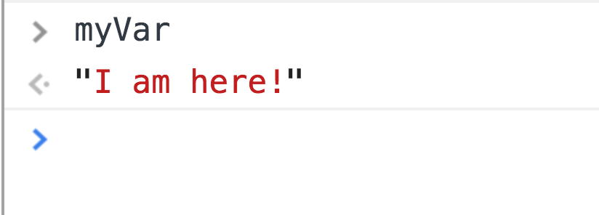
Variable Scope
This time just type out the variable but not in
a function
Again, type the variable on the Chrome Dev
tools command line and press ENTER

Slide 36
Variable Scope
The scope of this variable is
global. It can be accessed from
anywhere inside the program.
main.js
var anotherVar = “I am elsewhere”;
function test(){
var myVar = “I am here”;
}
The scope of this variable is
local to the function. That is, it
can only be accessed from code
that sits inside the function.

Slide 37
Lesson 5 – Adding Component Behaviour

Slide 38
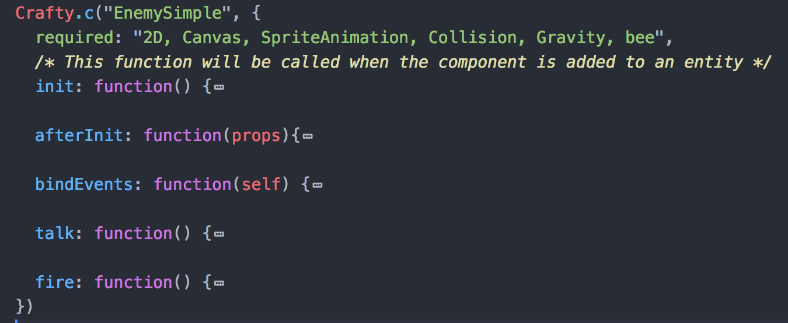
Create a Component
Create a Crafty component entity
Give the component Gravity

Slide 39
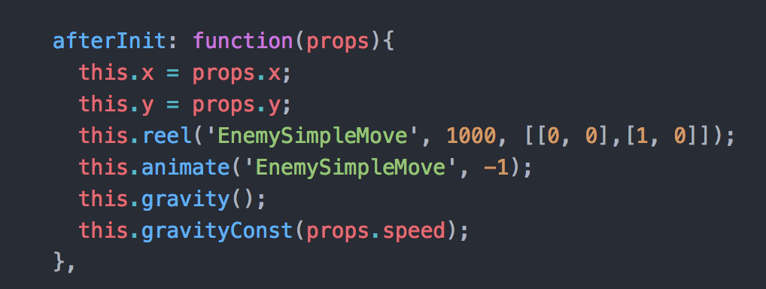
Components give you power!
Adding the Gravity component, gives your component/entity
extra functions. You can now set the gravity speed.

Slide 40
Lesson 6 – Multiple enemies!

Slide 41
Let’s say I had a character thus:
...and a function
function step()
... that makes the character take one step.
... What if you wanted him to take 10 steps?

Slide 42
You could call the function 10 times...?
step()
step()
step()
step()
step()
step()
step()
step()
step()
step()
Is that a good idea?
What if you wanted to take 1000 steps?

Slide 43
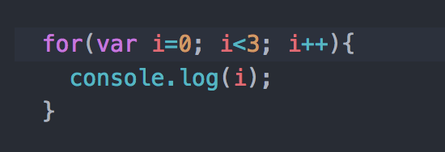
For....Loops
Another way of repeating an instruction!
counter
number of repetitions
code to run on each repetition

Slide 44
Lesson 7 – Events

Slide 45
Events in a Game
Level complete
Enemy is killed
Player loses a life
Game started
End of game
Score updated
High score reached

Slide 46
Events in a Game
When an EVENT occurs, we may want
to run some Javascript code!
EVENT 1
Run Code!

Slide 47
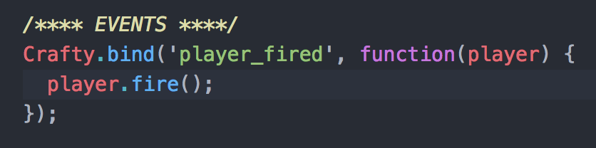
Events in a Game
To setup an event in Crafty, we must ‘bind’ it
The function that is run when
the event occurs
The name of the event

Slide 48
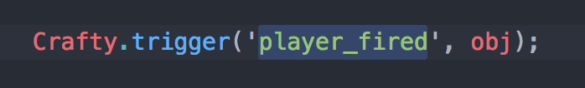
Events in a Game
To run an event in Crafty, we must trigger it
Data that is passed into the ’player_fired’ event code
Trigger the ‘player_fired’ event

